Slide 1
Process Management
Process Management - Processes; State + Resources; Threads; Unix implementation of Processes

Slide 2

Processes: The Process Model
Multiprogramming of four programs
Conceptual model of 4 independent, sequential processes
Only one program active at any instant

Slide 3
Processes and programs
The difference between a process and a program:
Baking analogy:
  Recipe = Program
  Baker = Processor
  Ingredients = data
  Baking the cake = Process
Interrupt analogy
  The baker’s son runs in with a wounded hand
  First aid guide = interrupt code

Slide 4
Main OS Process-related Goals
Interleave the execution of existing processes to maximize processor utilization
Provide reasonable response times
Allocate resources to processes
Support inter-process communication (and synchronization) and user creation of processes

Slide 5
How are these goals achieved?
Schedule and dispatch processes for execution by the processor
Implement a safe and fair policy for resource
allocation to processes
Respond to requests by user programs
Construct and maintain tables for each process managed by the operating system

Slide 6
Process Creation
When is a new process created?
System initialization (Daemons)
Execution of a process creation system call by a running process
A user request to create a process
Initiation of a batch job

Slide 7
Process Termination
When does a process terminate?
Normal exit (voluntary)
Error exit (voluntary)
Fatal error (involuntary)
Killed by another process (involuntary)

Slide 8
Processes: outline
Basic concepts
Process states and structures
Process management
signals
Threads
Specific implementations

Slide 9
Process States
Running - actually using the CPU
Ready – runnable, temporarily stopped to let another process run
Blocked - unable to run until some external event happens
A process can block itself, but not “run” itself

Slide 10
Process State Transitions
When do these transitions occur?
Running
1. Process blocks for input or waits for an event
2. End of time-slice, or preemption
3. Scheduler switches back to this process
4. Input becomes available, event arrives
1
2
3
Blocked
Ready
4

Slide 11
Five-State Process Model
Dispatch
Release
Admit
New
Ready
Running
Exit
Time-out
Event
Occurs
Event
Wait
Blocked

Slide 12

Scheduling: Single Blocked Queue
Ready Queue
Dispatch
Release
Admit
Processor
Time-out
Event Wait
Event
Occurs
Blocked Queue

Slide 13

Scheduling: Multiple Blocked Queues
Ready Queue
Dispatch
Release
Admit
Processor
Time-out
Event 1
Occurs
Event 1 Wait
Event 1 Queue
Event 2
Occurs
Event 2 Wait
Event 2 Queue

Slide 14
Suspended Processes
Processor is much faster than I/O so many processes could be waiting for I/O
Swap some of these processes to disk to free up more memory
Blocked state becomes blocked-suspended state when swapped to disk, ready becomes
ready-suspended
Two new states
  Blocked-suspended
  Ready-suspended

Slide 15
Process State Transition Diagram with Two Suspend States
New
Admit
Suspend
Admit
Activate
Dispatch
Ready,
suspend
Ready
Running
Exit
Suspend
Time out
Event
Occurs
Event
Wait
Event
Occurs
Activate
Blocked,
suspend
Blocked
Suspend

Slide 16
Process Management Operations
Process creation and termination
Process scheduling and dispatching
Process switching
Process synchronization and support for inter-process communication
The OS maintains process data in the
Process Control Blocks (PCB)

Slide 17
Process Table
Process image consists of program (code/text), data, stack, and attributes
Control Attributes form the Process Control Block - PCB
  Unique ID (may be an index into the PT)
  User ID; User group ID, Parent process ID
  process control information
  Processor state information

Slide 18
Process Control Information
Additional information needed by the operating system to control and coordinate the various active processes
  Execution state: see next slide…
  Scheduling-related information - state; priority; scheduling info
  inter-process communication - signals; pipes
  Time of next alarm
  memory management - pointers to text/data/stack
  segments
  resource ownership and utilization - open files
  Process relationships: Parent, process group…
  Environment variables

Slide 19
Processor State Information
Contents of processor registers
  General registers
  Program counter
  Program Status Word (PSW)
    condition codes
    mode (user/kernel)
    status register - interrupts disabled/enabled
  Stack pointers - user and kernel stacks

Slide 20
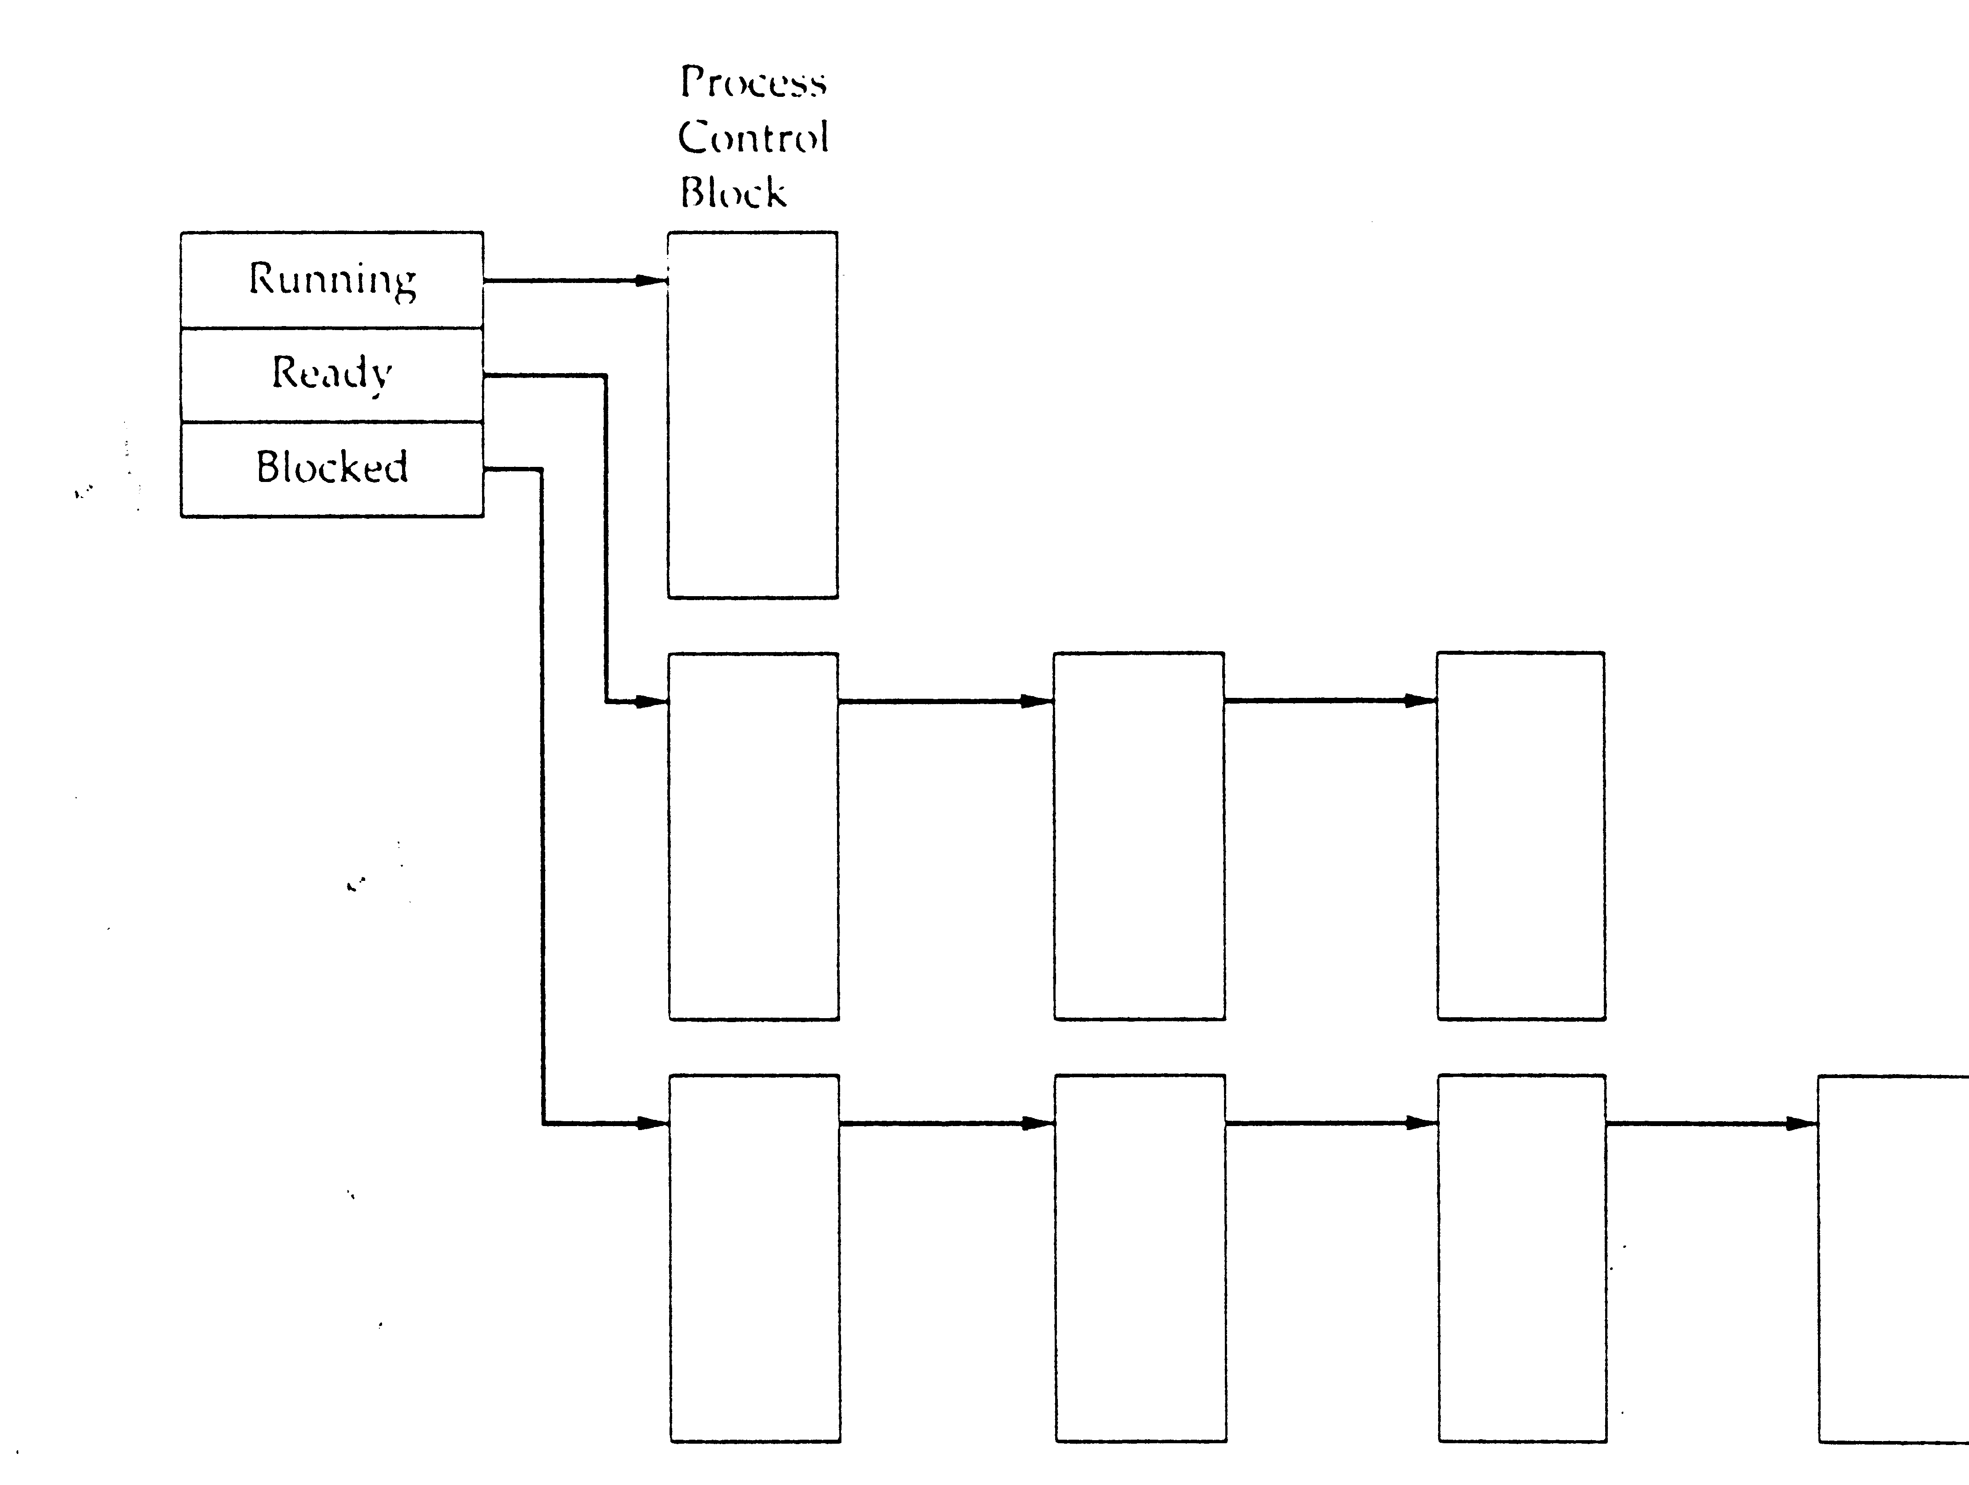
Process-State-Management
Process
Control
Block
Running
Ready
Blocked

Slide 21
Processes: outline
Basic concepts
Process states and structures
Process management
signals
Threads
Specific implementations

Slide 22
Process Creation
Assign a unique process identifier
Allocate space for the process
Initialize process control block
Set up appropriate linkage to the scheduling queue:
  In the former example: add the PCB to the ready queue

Slide 23
Stop a running process
  Clock event: process has executed a full
  time-slice (a.k.a. time-quantum)
  Process becomes blocked
  Another process is ready
  Error occurred
  Signal received

Slide 24
Process Context Switch
Save processor context, including program counter and other registers
Update the process control block with the new state and any accounting information
Move process control block to appropriate queue - ready, blocked
Select another process for execution
Update the process control block of the process selected
Update memory-management data structures
Restore context of selected process

Slide 25
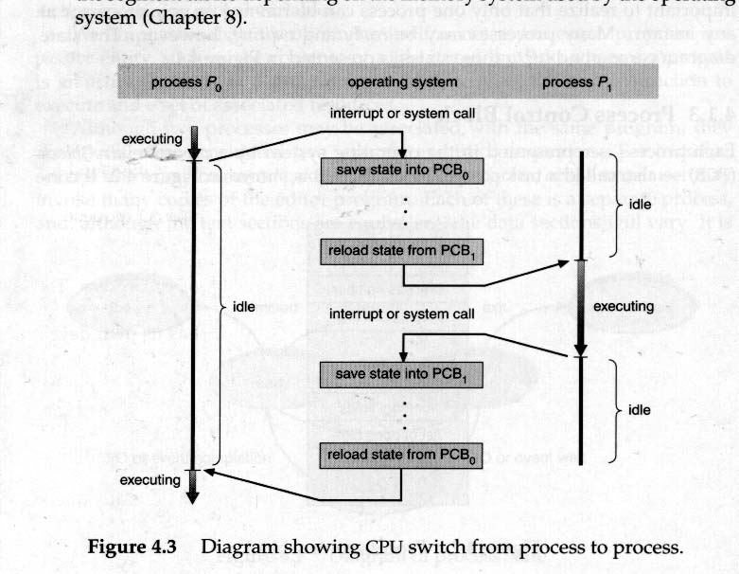
Switching Processes

Slide 26
Managing Processes (Unix)
pid = fork() - create a child process
wait(status) / waitpid(pid, status, opts) - wait for termination of a child. Either blocks, gets child return-code, or exit code (if no children)
execvp(name, args) – replace image by name, with arguments args
exit(status)

Slide 27
The Unix Process
fork system call:
  memory address space is “copied”
  parent receives pid of child (value of fork())
  child gets 0 (value of fork())
pid = fork(); /* upon success of fork() pid > 0 in parent */
if (pid < 0) { /* fork failed - memory full ... table full */
} else if (pid > 0) { /* Parent code goes here ... */
} else { /* Child code goes here ... */
}
* to find own pid - getpid()

Slide 28
Process Creation in Unix – fork()
Check to see if process table is full
Try to allocate memory to child’s data and stack
Copy the parent’s code, data and stack to the child’s memory (“copy on write” trick…)
Find a free process slot and copy parent’s slot to it
Enter child’s memory map in process table
Inform kernel and file system about the child
Return the appropriate PIDs to parent and child

Slide 29
Executing a New Program (Unix)
Children are duplications of their parents
In order to perform another program, the program code is loaded to the process' image:
  the fork() system call creates a new process
  execvp system call (used after fork() ) replaces the process core image with that of another executable program

Slide 30
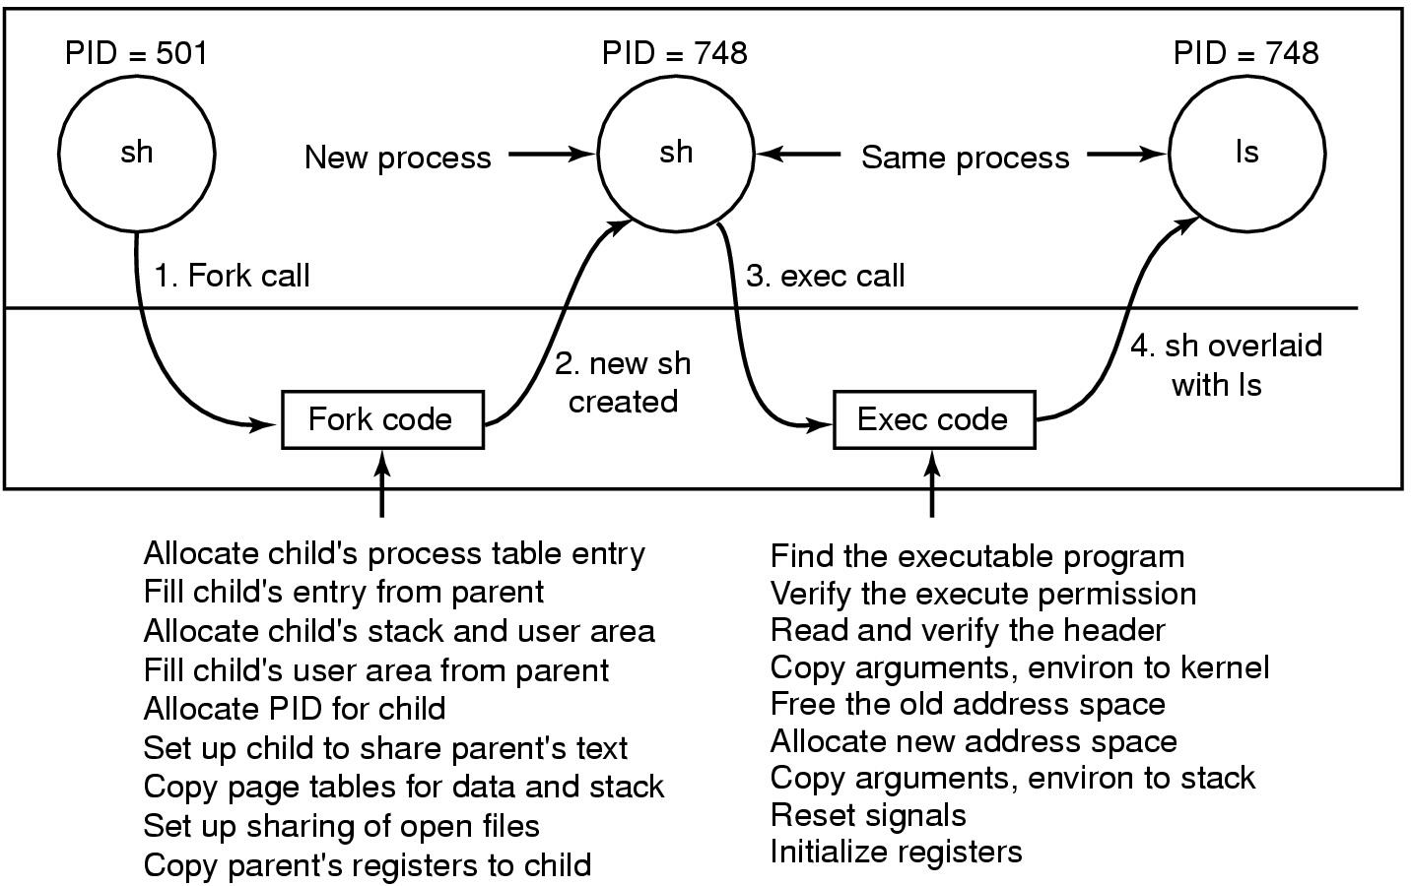
Executing the ls command
User
code
Kernelcode
Steps in executing the command ls, typed to the shell

Slide 31
Processes: outline
Basic concepts
Process states and structures
Process management
Signals
Threads
Specific implementations

Slide 32
Unix signals
A signal is a software interrupt
Signals are generated:
  From the keyboard: Ctrl-C, Ctrl-Z, …
  From the command line: kill -<sig> <PID>
  Using a system call: kill(PID, sig)
A process can send a signal to all processes within its process group

Slide 33
Handling signals
Upon receiving a signal the process can:
  Ignore it (not always…)
  Let the system take default action
  Catch it by a process' signal handler
This is accomplished by calling:
signal(signum, [function | SIG_IGN | SIG_DFL ]);

Slide 34
More on Unix signals
kernel sets signal bits in the PCB upon receiving signals (software interrupt)
Some Examples (predefined signal numbers):
  sigabrt - abort process (core dump)
  sigalrm - alarm clock (alarm, sleep, pause)
  sigsegv - segmentation violation (invalid address)
  sigkill – kill the process
  sigill - illegal instruction
Upon child process termination, the signal SIGCHILD is sent to parent. If parent executes wait(), it gets the exit code too

Slide 35
Signals: a simple example
int main(void) {
if (signal(SIGUSR1, sig_usr) == SIG_ERR)
err_sys(“can’t catch SIGUSR1”);
if (signal(SIGUSR2, sig_usr) == SIG_ERR)
err_sys(“can’t catch SIGUSR2”)
for ( ; ; )
pause(); }
Static void sig_usr(int signo) {
if (signo == SIGUSR1)
printf(“received SIGUSR1\n”);
else if (signo == SIGUSR2)
printf(“received SIGUSR2\n”);
else
err_dump(“received signal %d\n”, signo); }

Slide 36
Unix signals: terminology & semantics
A signal is generated for a process when the event that causes it occurs. This usually causes the setting of a bit in the PCB
A signal is delivered to a process when the action for the signal is taken
During the time when a signal is generated and until it is delivered, the signal is pending
A process has the option of blocking the signal (signals mask)
If a signal is generated multiple times while it is blocked, it is typically delivered only once

Slide 37
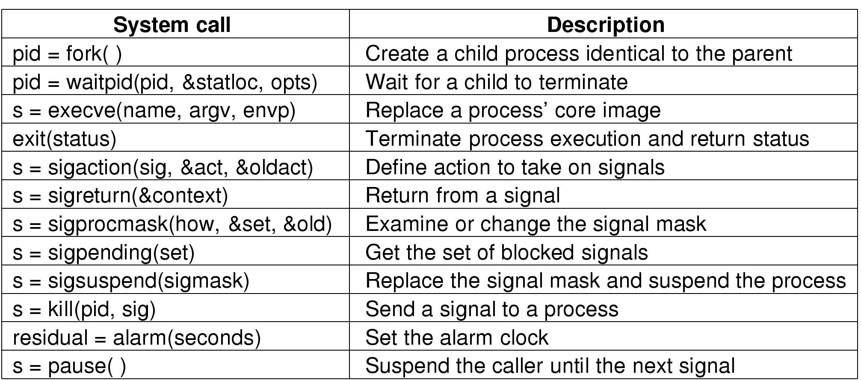
System Calls for Process Management
s is an error code
pid is a process ID
residual is the remaining time from the previous alarm

Slide 38
Terminated processes
If a child process terminates and the parent doesn’t execute `wait’, the child becomes a zombie – it still holds a PTE
An ancestor can receive the process exit code stored in the PTE
Zombie entries can be erased by the kernel when an ancestor executes a wait() system call
What happens if the parent terminates before the child?

Slide 39
Processes: outline
Basic concepts
Process states and structures
Process management
Signals
Threads
Specific implementations

Slide 40
Threads
Need:
  Multiprogramming within a single application
  Using the same environment for performing different tasks concurrently

Slide 41
Single and multithreaded processes
process control block
code
data
files
process control block
code
data
files
registers
user/kernel stacks
registers
registers
registers
Thread control blocks
user
/kernel
stacks
user
/kernel
stacks
user
/kernel
stacks
thread
thread
thread
thread
single threaded
multithreaded

Slide 42
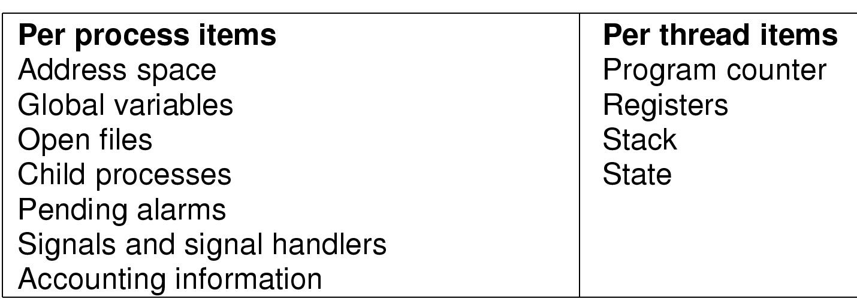
The Thread Model

Slide 43
Processes Threads
The basic unit of CPU scheduling - threads:
  program counter; register set; stack space
Peer threads share resources like code section and data section
a process is created with a single thread
multi-threaded tasks (processes) can have one thread running while another is blocked
Good for applications that require sharing a common buffer by server threads
A word processor can use three threads
  Updating the display (WYSIWYG)
  Interacting with the user (keyboard & mouse)
  Dealing with i/o to the disk

Slide 44
Processes Threads
Multithreading in different operating systems:
  Operating systems support multiple threads of execution within a single process
  Older UNIX systems supported multiple user processes but only one thread per process; new Unix systems have multiple threads.
  Windows NT supports multiple threads

Slide 45
The Benefits of Threads
Takes less time to create a new thread than a process
Less time to terminate a thread than a process
Less time to switch between two threads within the same process
Threads within the same process share memory and files --> they can communicate without invoking the kernel

Slide 46
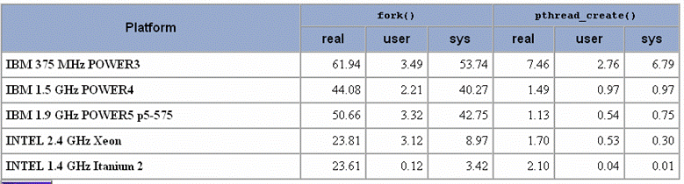
Creation time: process vs. thread

Slide 47
More on Threads
Per-thread dynamic storage for local variables
Access to process' memory and resources
  all threads of a process share these
Suspending a process suspends all process threads since all threads share the same PTE
Termination of a process, terminates all threads within the process

Slide 48
Issues of threads
Fork – should all threads be inherited?
If so, and a parent thread was blocked on keyboard read, would the corresponding child thread be in the same state?
What if one thread closes a file while the other is still reading it?
Which threads should receive signals?
…
Careful design is required!

Slide 49
Kernel vs Application (User) threads
threads
processes
threads
processes
User space
User space
Kernel space
kernel
Kernel space
kernel
Runtime system
Process table
Process table
Threads table
Threads table

Slide 50
User-Level Threads
All thread management is done by the application
The kernel is not aware of the existence of threads
Thread switching does not require kernel mode privileges (and is thus faster)
Scheduling is application specific (can thus be more efficient)
System calls by threads block the process

Slide 51
User-level Threads - Problems
Blocking read – all other threads are blocked!
  In Unix, use “select” - if data not in buffer, switch to another thread
Page fault – all other threads are blocked!
Time limit– cannot handle clock interrupts PER THREAD! Need other method e.g, thread_yield
Stack growth fault – kernel is not aware of which thread’s stack caused the fault!

Slide 52
Kernel-level Threads
Kernel maintains context information for the process and the threads
Kernel can schedule different threads of the same process to different processors
Switching between threads requires the kernel
Kernel threads can simplify context switch of system functions

Slide 53
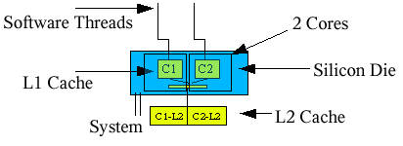
Multi-cores:
Chip Multi-Threading (CMT)
Multiple cores on the same silicon die
On-core L1 cache
External L2 cache (may be either split or joined)
Notes:
The figure shows a dual-core chip, where each core has on-chip level-1 cache and an external
L2-cache. In some designs, the L2 cache is shared between the 2 cores.

Slide 54
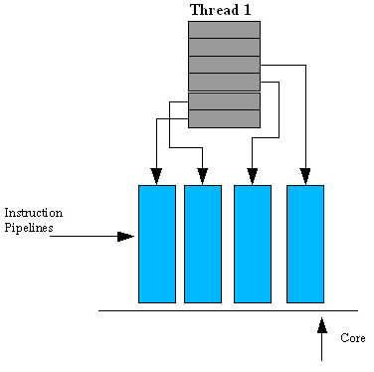
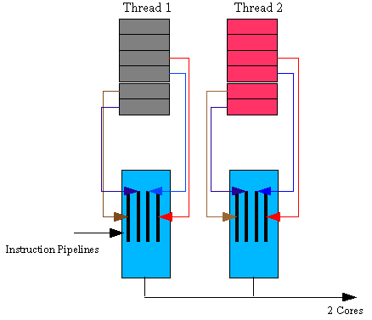
Execution on single-core vs. multi-core
Pipelining permits instruction-level parallelism (ILP)
Multi-core permits both ILP and Thread-Level-Parallelism (TLP) on same CPU
Execution on single-core
Execution on dual-core

Slide 55
Simultaneous multi-threading:
Hardware threads
Core stores more registers and logic for much faster thread context-switch
A hardware thread appears as a logical processor to the operating system
  Scheduler more efficient if OS aware of HW threads
E.g., Sun's UltraSPARC T2 chip contains 8 cores, each comprising 8 HW cores for a total of 64 concurrent threads

Slide 56
Processes: outline
Basic concepts
Process states and structures
Process management
Signals
Threads
Specific implementations

Slide 57
Solaris 2-8: A Combined Approach for Threads
Thread creation, scheduling and synchronization can be done in user space
Multiple user-level threads are mapped onto some (smaller or equal) number of kernel-level threads
In Unix Solaris, a kernel thread into which user threads can be mapped is called LWP (light-weight process) and an API is provided to map a user thread to a LWP
Some kernel threads have no associated LWP
A user thread may be bound to a LWP for quick response
Many-to-many model

Slide 58
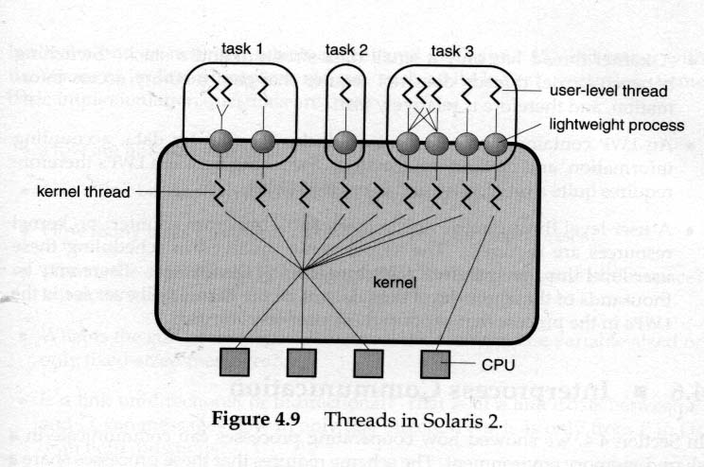
Threads in Solaris

Slide 59
Threads & LWP Structure
Threads
Threads library
LWPs
Kernel - OS Scheduler

Slide 60
Threads in Unix-Solaris
thr_create create thread
thr_join causes the calling thread to wait until target thread is finished
thr_exit destroy calling thread
thr_suspend suspend target thread
thr_continue make suspended thread active
thr_setconcurrency set desired number threads active at the same time to a new parameter
thr_getconcurrency get current concurrency level
thr_setprio set thread relative priority
thr_getprio get relative priority of the thread
thr_yield causes the current thread to yield its execution in favor of another thread with the same or greater priority
thr_kill kill a thread
thr_keycreate allocate a key that locates data specific to each thread in the process
thr_min_stack amount of space needed to execute a null thread
thr_setspecific binds thread-specific value to the key
thr get-specific gets thread-specific value of the key

Slide 61
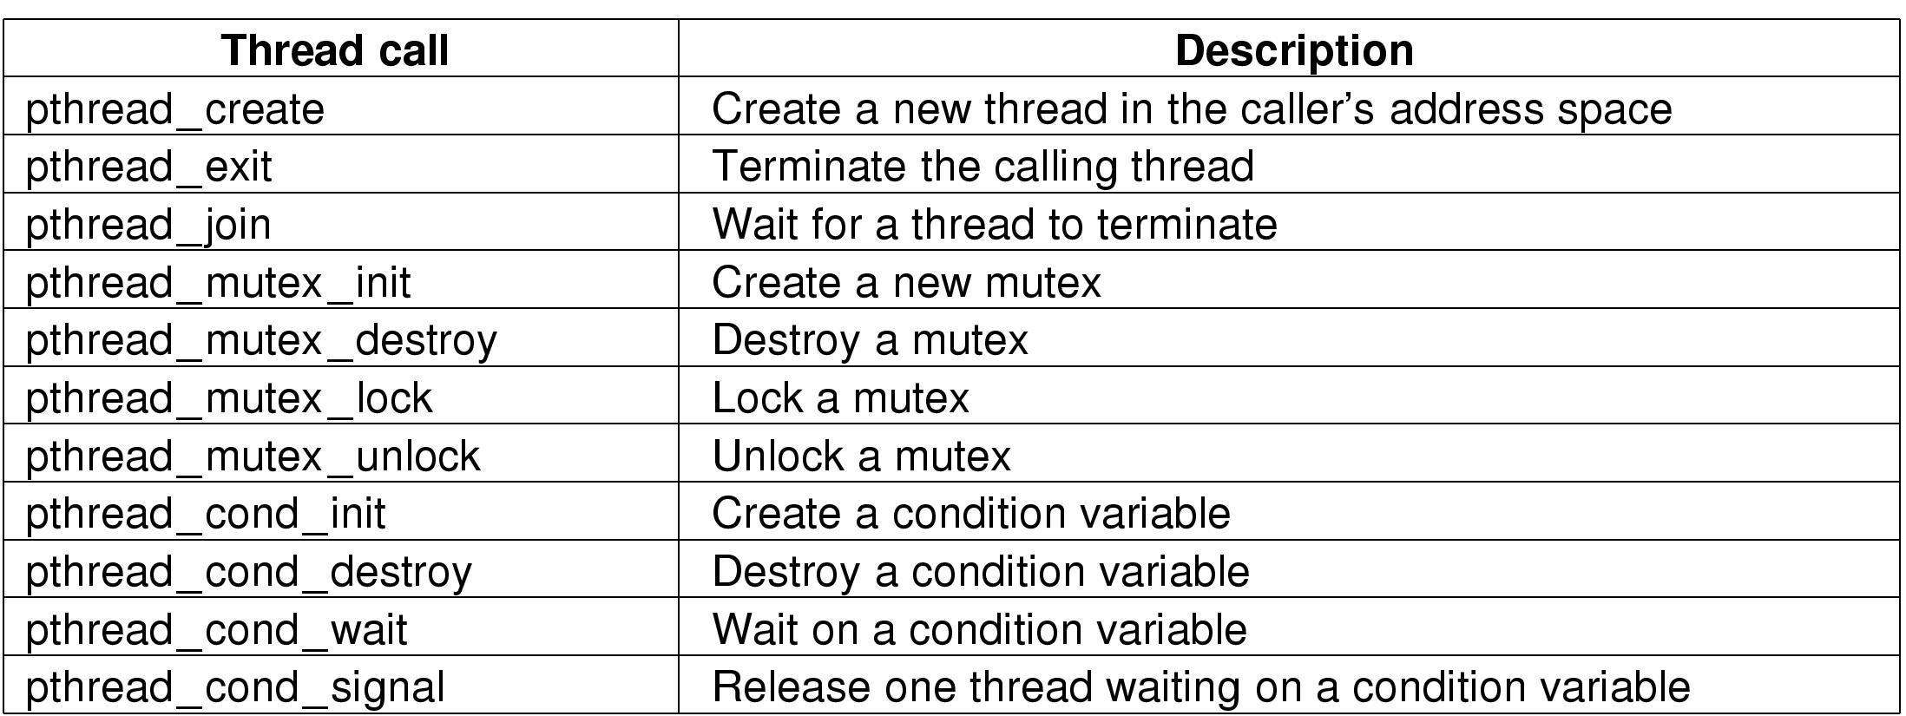
Threads in POSIX
The principal POSIX thread calls.

Slide 62
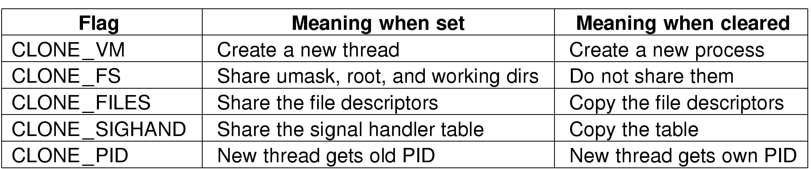
Threads – Sharing options (Linux)
Pid = clone(function, stack_ptr, sharing_flags, arg);
Bits in the sharing_flags bitmap

Slide 63
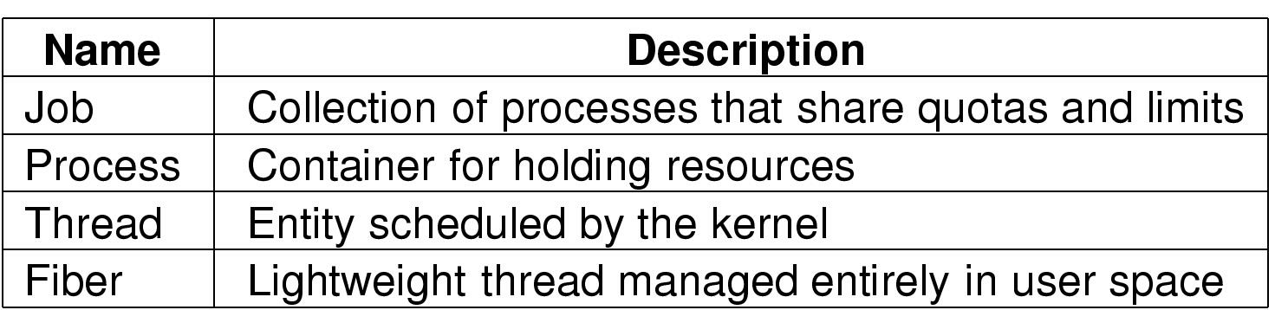
Windows – Processes and Threads
Basic concepts used for CPU and resource management

Slide 64
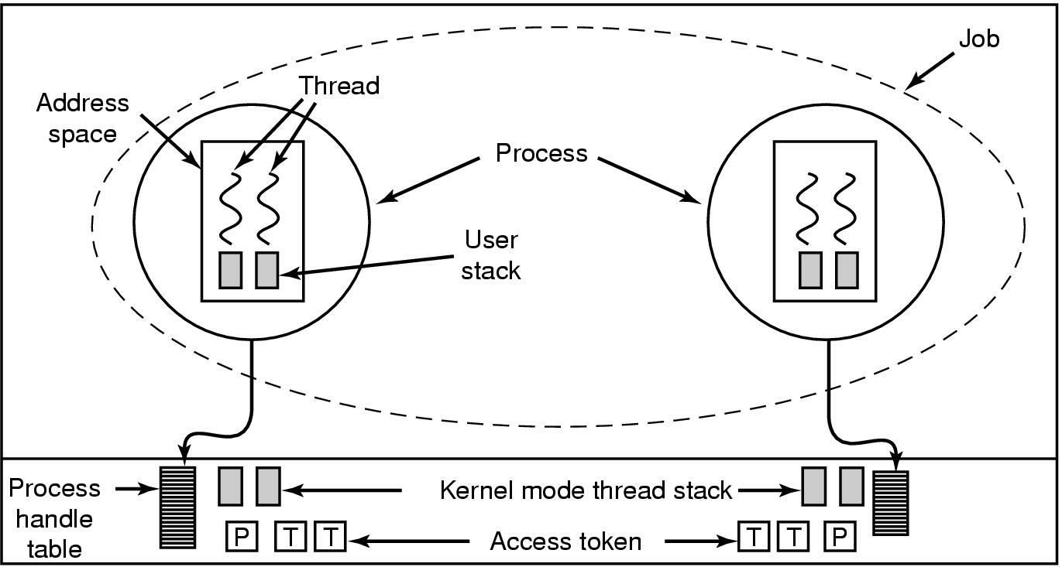
Windows: jobs, processes, threads
Relationship between jobs, processes,
threads (fibers not shown in figure)

Slide 65
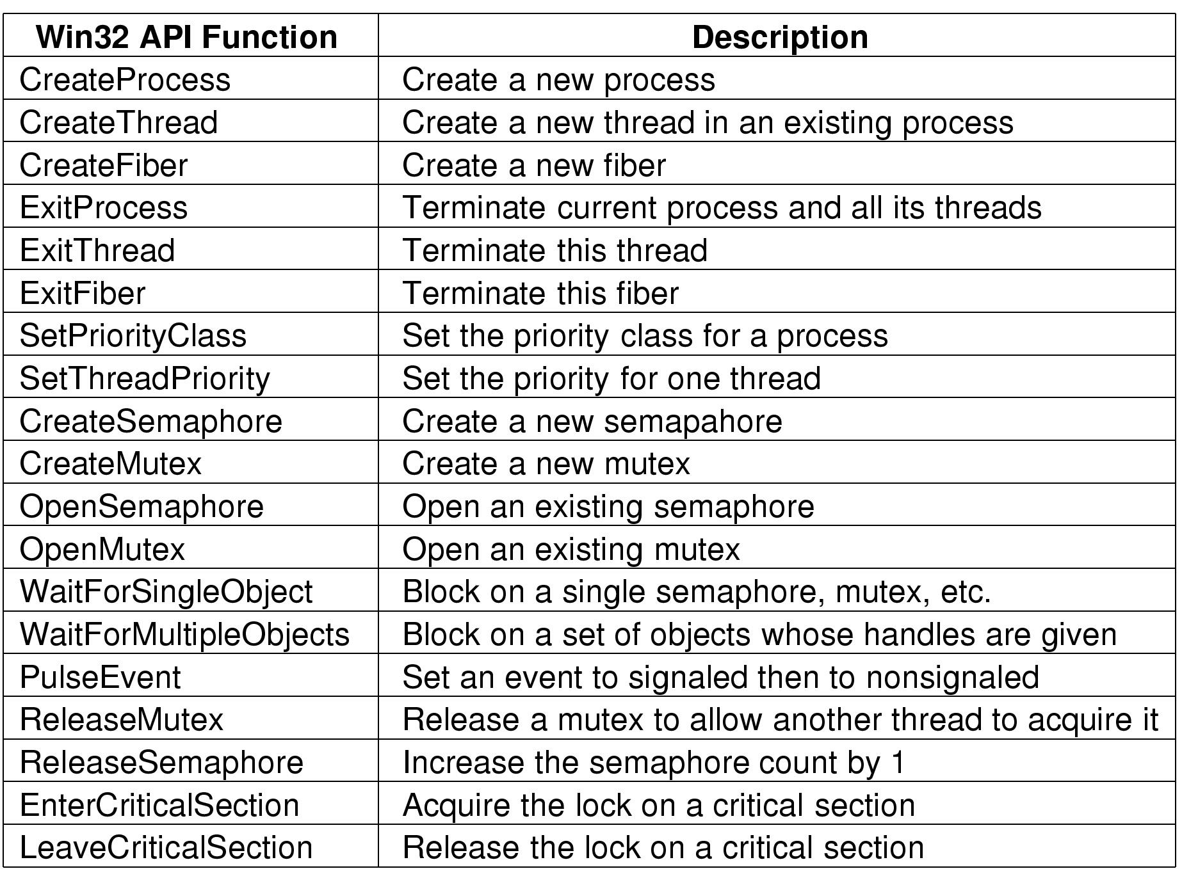
Job, Process, Thread & Fiber - Mgmt. API Calls
Some Win32 calls for managing processes, threads and fibers

Slide 66
Inter-Process Communication
Shared memory – the fastest way
  Need to avoid race conditions
Non-shared Memory:
  File/Pipes
  Unbuffered messages - Rendezvous
  Buffered messages – Mailboxes and Sockets
  Sockets: Address – Domain+Port
  Sockets: Types – Stream or Datagrams
  Sockets: API: Socket, Bind, Connect, Read/Write

